Slide 1
RAIK 283: Data Structures & Algorithms
Divide and Conquer (II)*
Dr. Ying Lu
ylu@cse.unl.edu
*slides referred to
http://www.aw-bc.com/info/levitin
Design and Analysis of Algorithms – Chapter 5

Slide 2
What’s the difference?
Consider the problem of exponentiation: Compute a^{n}
Brute Force:
Decrease by one:
Decrease by constant factor:
Divide and conquer:
Design and Analysis of Algorithms – Chapter 4
Notes:
Try to get the students involved in coming up with these:
Brute Force:
a^{n}= a*a*a*a*...*a
n
Divide and conquer:
a^{n}= a^{n/2} * a^{n/2}
Decrease by one:
a^{n}= a^{n-1}* a (one hopes a student will ask what is the difference with brute force here
there is none in the resulting algorithm, of course, but you can arrive
at it in two different ways)
Decrease by constant factor:
a^{n}= (a^{n/2})² (again, if no student asks about it, be sure to point out the difference
with divide and conquer. Here there is a significant difference that leads to a
much more efficient algorithm – in divide and conquer we re-compute a^{n/2)}

Slide 3
Divide and conquer examples
Large integer multiplication
Strassen’s matrix multiplication
Design and Analysis of Algorithms – Chapter 5

Slide 4
Multiplication of large integers
a , b are both n-digit integers
If we use the brute-force approach to compute c = a * b, what is the time efficiency?
Design and Analysis of Algorithms – Chapter 5

Slide 5
Multiplication of large integers
(divide-conquer recursive algorithm I ]
a = a₁a₀ and b = b₁b₀
c = a * b
  = (a₁10^{n/2} + a₀) * (b₁10^{n/2} + b₀)
  =(a₁ * b₁)10^{n} + (a₁ * b₀ + a₀ * b₁)10^{n/2} + (a₀ * b₀)
  For instance: a = 123456, b = 117933:
  Then c = a * b = (123*10³+456)*(117*10³+933)
  =(123 * 117)10⁶ + (123 * 933 + 456 * 117)10³ + (456 * 933)
Design and Analysis of Algorithms – Chapter 5

Slide 6
Multiplication of large integers
a = a₁a₀ and b = b₁b₀
a, b: n-digit integers
a₁, a₀, b₁, b₀: n/2-digit integers
c = a * b
  =(a₁ * b₁)10^{n} + (a₁ * b₀ + a₀ * b₁)10^{n/2} + (a₀ * b₀)
  How many single-digit multiplications are needed to compute a*b, if we ignore the shifting operations required for multiplying 10^{n} and 10^{n/2}?
Design and Analysis of Algorithms – Chapter 5

Slide 7
Multiplication of large integers
(divide-conquer recursive algorithm II ]
a = a₁a₀ and b = b₁b₀
c = a * b
  =(a₁ * b₁)10^{n} + (a₁ * b₀ + a₀ * b₁)10^{n/2} + (a₀ * b₀)
  =c₂10^{n} + c₁10^{n/2} + c₀,
  where
  c₂ = a₁ * b₁ is the product of their first halves
  c₀ = a₀ * b₀ is the product of their second halves
  c₁ = (a₁ + a₀) * (b₁ + b₀) – (c₂ + c₀) is the product of the sum of the a’s halves and the sum of the b’s halves minus the sum of c₂ and c₀.
Design and Analysis of Algorithms – Chapter 5

Slide 8
Multiplication of large integers
c =c₂10^{n} + c₁10^{n/2} + c₀,
  where
  c₂ = a₁ * b₁
  c₀ = a₀ * b₀
  c₁ = (a₁ + a₀) * (b₁ + b₀) – (c₂ + c₀)
  How many single-digit multiplications are needed to compute a*b, if we ignore the shifting operations required for multiplying 10^{n} and 10^{n/2}?
Design and Analysis of Algorithms – Chapter 5

Slide 9
Multiplication of large integers
c =c₂10^{n} + c₁10^{n/2} + c₀,
  where
  c₂ = a₁ * b₁
  c₀ = a₀ * b₀
  c₁ = (a₁ + a₀) * (b₁ + b₀) – (c₂ + c₀)
  Multiplication of n-digit numbers requires three multiplications of n/2-digit numbers
Design and Analysis of Algorithms – Chapter 5

Slide 10
Multiplication of large integers
M(n) = 3M(n/2) for n>1, M(1) = 1
Design and Analysis of Algorithms – Chapter 5

Slide 11
Multiplication of large integers
M(n) = 3M(n/2) for n>1, M(1) = 1
M(n) ≈ n^{1.585}
Design and Analysis of Algorithms – Chapter 5

Slide 12
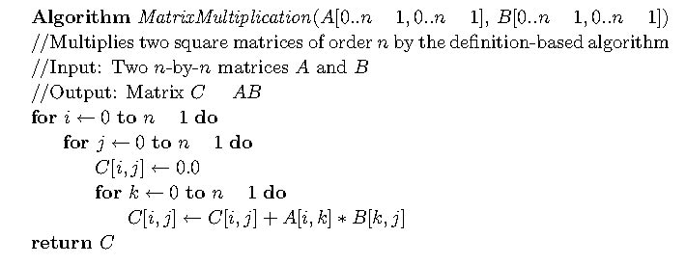
Matrix multiplication (brute force]
-
-
-
-
=
-
-
-
multiplication: Θ(n³) addition: Θ(n³)
Design and Analysis of Algorithms – Chapter 5

Slide 13
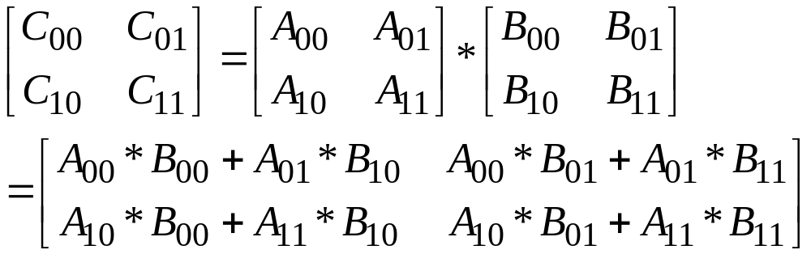
Matrix multiplication
(divide-conquer recursive algorithm]
A, B: n by n matrices;
A_{ij}, B_{ij}: n/2 by n/2 matrices, where i, j ∈ {0, 1}
recurrence relations:
multiplication: M(n) = ?
addition: A(n) = ?
Design and Analysis of Algorithms – Chapter 5

Slide 14
Matrix multiplication (divide-conquer]
A, B: n by n matrices;
A_{ij}, B_{ij}: n/2 by n/2 matrices, where i, j ∈ {0, 1}
multiplication: Θ(n³) addition: Θ(n³)
Design and Analysis of Algorithms – Chapter 5

Slide 15
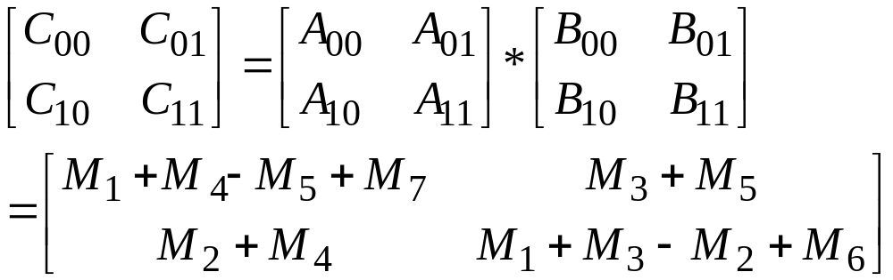
Strassen’s matrix multiplication
M₁=(A₀₀+A₁₁)*(B₀₀+B₁₁)
M₂=(A₁₀+A₁₁)*B₀₀
M₃=A₀₀*(B₀₁-B₁₁)
M₄=A₁₁*(B₁₀-B₀₀)
M₅=(A₀₀+A₀₁)*B₁₁
M₆=(A₁₀-A₀₀)*(B₀₀+B₀₁)
M₇=(A₀₁-A₁₁)*(B₁₀+B₁₁)
recurrence relations:
multiplication: M(n) = ?
addition: A(n) = ?
Design and Analysis of Algorithms – Chapter 5

Slide 16
Strassen’s matrix multiplication
M₁=(A₀₀+A₁₁)*(B₀₀+B₁₁)
M₂=(A₁₀+A₁₁)*B₀₀
M₃=A₀₀*(B₀₁-B₁₁)
M₄=A₁₁*(B₁₀-B₀₀)
M₅=(A₀₀+A₀₁)*B₁₁
M₆=(A₁₀-A₀₀)*(B₀₀+B₀₁)
M₇=(A₀₁-A₁₁)*(B₁₀+B₁₁)
M(n) ≈ Θ(n^{2.807})
A(n) ≈ Θ(n^{2.807})
Design and Analysis of Algorithms – Chapter 5

Slide 17
In-Class Exercise 1
Given a sorted array of distinct integers A[1…n], you want to find out whether there is an index i for which A[i] = i. Given an algorithm that runs in time O(logn).
Design and Analysis of Algorithms – Chapter 5

Slide 18
In-Class Exercise 2
An array A[1 … n] is said to have a majority element if more than half of its entries are the same. Given an array, the task is to design an efficient algorithm to tell whether the array has a majority element, and, if so, to find that element. The elements of the array are not necessarily from some ordered domain like the integers, and so there can be no comparisons of the form “is A[i] > A[j]?”. (Think of the array elements as GIF files, say.) However you can answer questions of the form: “is A[i] = A[j]?” in constant time. What’s the time efficiency of your algorithm?
Design and Analysis of Algorithms – Chapter 5

